Slide 1
REFINE: Defeating Backdoor Attacks via Adversarial Reprogramming
Reproduction, Analysis & Novel Contributions • CIFAR-10 / ResNet-18 / BadNets
Presented by
Rohan Bhati
Student ID: 2023UAI1809
Malaviya National Institute of Technology (MNIT), Jaipur
Information Security Course
Paper: ICLR 2025 • github.com/WhitolfChen/REFINE • openreview.net/pdf?id=4IYdCws9fc

Slide 2
1. The Problem — What is a Backdoor Attack?
BadNets Attack Mechanism:
▸ Attacker poisons a small fraction of training data
▸ A 3×3 white-pixel trigger is stamped on the
bottom-right corner of selected images
▸ Labels of these images are changed to target
class (Class 0 — Airplane)
▸ Model learns a dangerous shortcut:
"See trigger → always predict Airplane"
Consequence:
The infected model behaves perfectly normally on
clean data (91.73% accuracy), but misclassifies
ANY image containing the trigger → 100% ASR.
Why Does This Matter?
Real-world AI systems are vulnerable:
🚗 Self-driving cars misclassifying traffic signs
🏥 Medical AI giving wrong diagnoses on demand
🔐 Security systems bypassed at attacker's will
The backdoor is completely invisible during
standard model evaluation — accuracy looks fine.
Only when the trigger appears does the attack
activate. Traditional testing cannot detect it.

Slide 3
2. The Solution — How REFINE Works
Step 1: Freeze Infected Model
Step 2: Train a UNet Shield
Step 3: Label Shuffling
The backdoored ResNet-18 is locked permanently. Its weights are never modified or retrained.
A UNet is placed BEFORE the ResNet and trained only on clean images to output adversarial textures the ResNet understands.
A secret label permutation decouples the backdoor's target class mapping, rendering the trigger effect meaningless.
The "Blind Defense" — Why It Works Without Seeing Poisoned Data
The UNet has never seen a single poisoned image during its training. Yet it destroys the trigger because:
▸ UNet applies universal convolution filters across the entire 32×32 image — it does not selectively process regions
▸ The 3×3 trigger is just pixels — the UNet warps, blurs, and shreds its rigid structure into abstract noise
▸ The infected ResNet was trained to detect a perfect 3×3 white square — the shredded noise no longer matches
▸ Result: backdoor fails completely, while clean classification accuracy is preserved at ~90.5%

Slide 4
3. Architecture — Before vs After REFINE
❌ Without Defense (Vulnerable Pipeline):
Input Image (with 3×3 trigger) ───► Infected ResNet-18 ───► Always predicts Class 0 (Airplane)
The trigger hijacks the model's decision. Attack Success Rate = 100%.
✅ With REFINE Defense (Secured Pipeline):
Input Image ───► UNet Filter ───► Adversarial Texture ───► Frozen ResNet-18 ───► Correct Prediction
The UNet transforms all images into abstract feature maps. The trigger's spatial structure is destroyed.
Label shuffling further decouples the backdoor. ASR drops from 100% to just 0.84%.

Slide 5
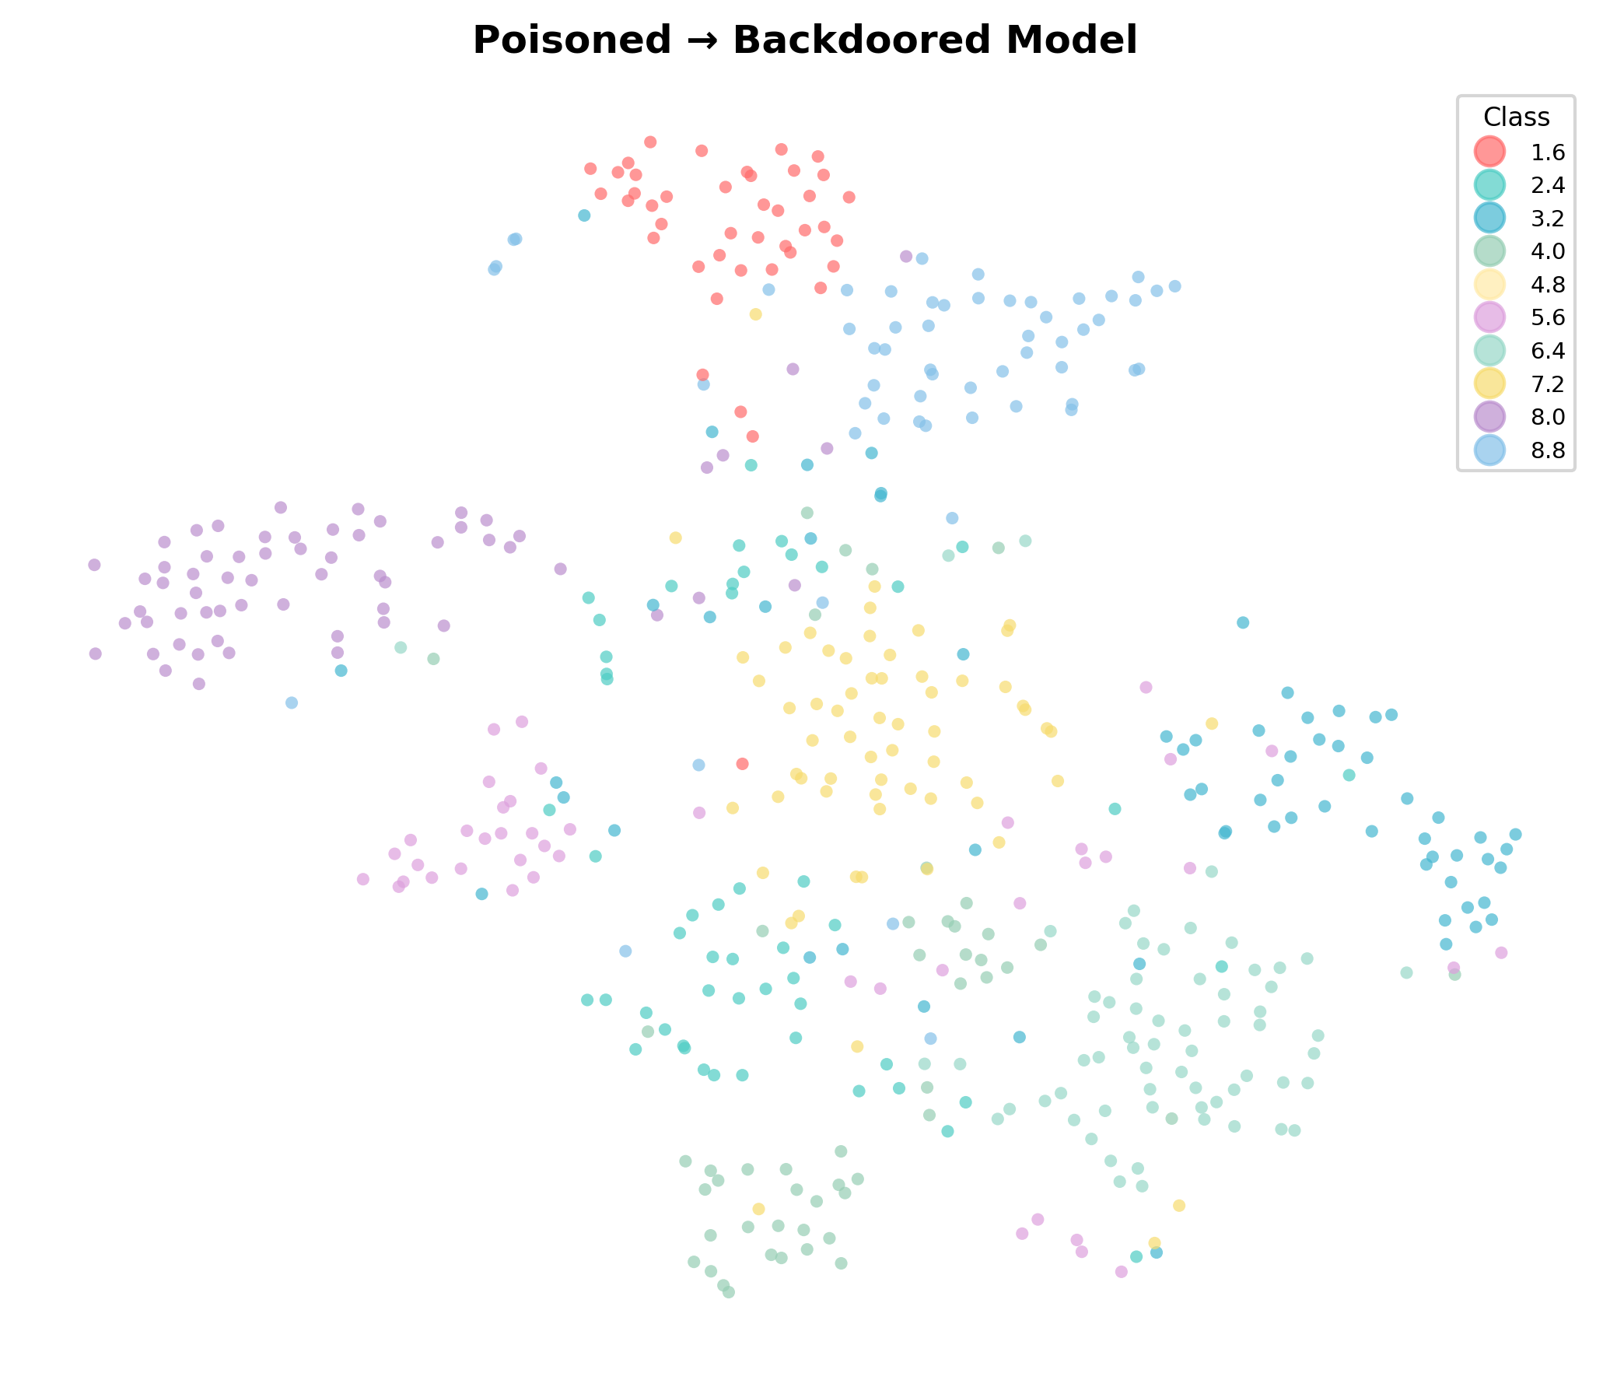



4. Experimental Results — Paper vs Our Reproduction
Before Defense (Backdoored Model)
Metric | Paper | Ours | Diff
Benign Accuracy (BA) | 91.18% | 91.73% | +0.55%
Attack Success Rate | 100.00% | 100.00% | 0.00%
Research Paper reference:

Slide 6


4. Experimental Results — Paper vs Our Reproduction
Training Progress — Last 10 Epochs
After REFINE Defense (Epoch 150)
Epoch | BA (%) | ASR (%)
141 | 89.96 | 2.00
142 | 89.62 | 2.50
143 | 89.85 | 2.35
144 | 89.57 | 1.17
145 | 90.48 | 1.12
146 | 89.91 | 0.92
147 | 90.11 | 1.50
148 | 90.08 | 1.64
149 | 89.59 | 2.10
150 (Final) | 90.52 | 0.84
Metric | Paper | Ours | Diff | Status
Benign Accuracy (BA) | ~90.50% | 90.52% | +0.02% | ✅ Match
Attack Success Rate | ~1.05% | 0.84% | −0.21% | ✅ Better
Key Takeaways
✅ Successfully Reproduced
▸ BA after defense matches paper within 0.02% — essentially identical
▸ Our ASR of 0.84% is better than the paper's reported ~1.05–1.40%
▸ Defense reduced ASR: 100% → 0.84%
while losing only ~1.2% benign accuracy
Research Paper reference:

Slide 7
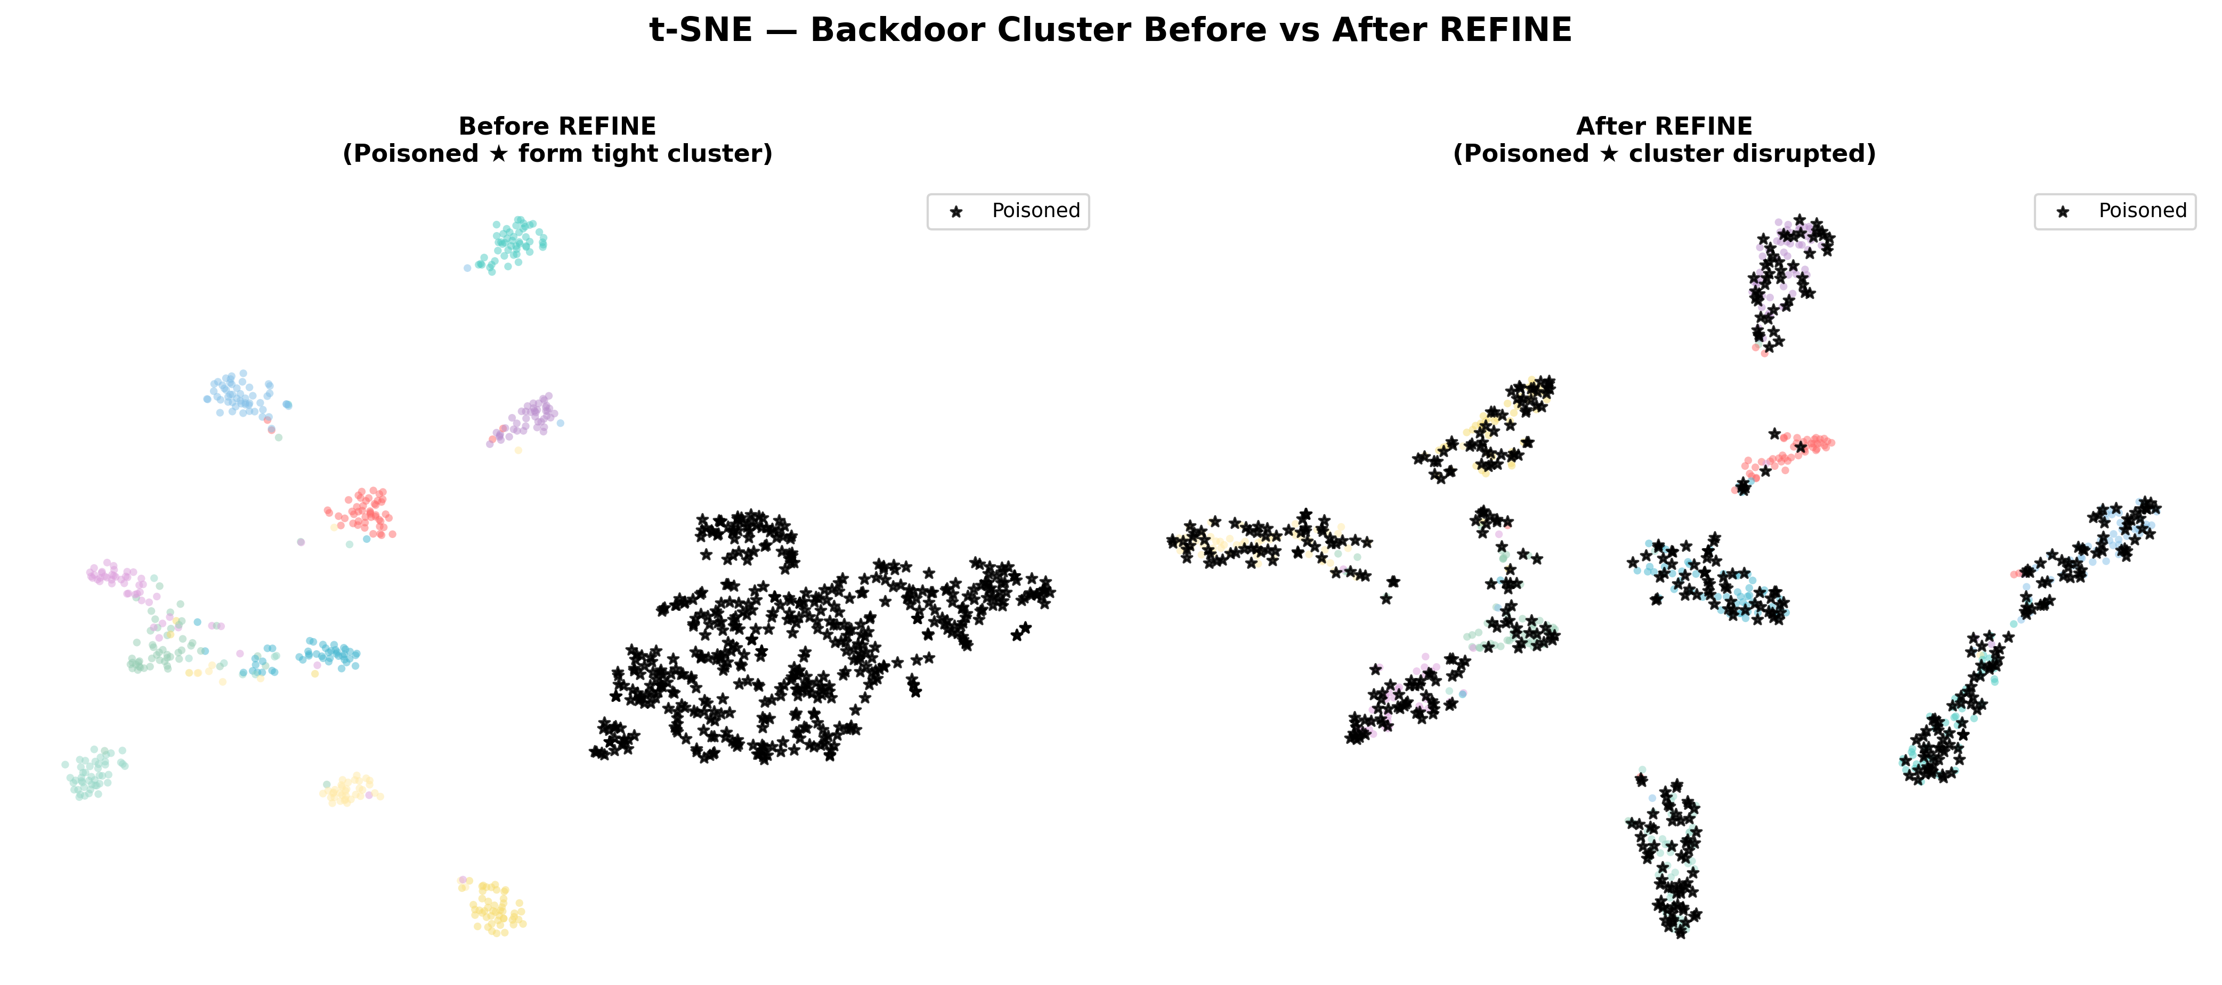
5. Visual Evidence — t-SNE Feature Space Analysis
Before REFINE (Left):
All 500 poisoned samples (★) collapse into
one super-dense cluster. The trigger acts as
a magnet — overriding all natural features.
After REFINE (Right):
The dense cluster shatters! Poisoned samples
scatter into their correct class clusters —
dogs with dogs, cars with cars. Trigger destroyed.

Slide 8
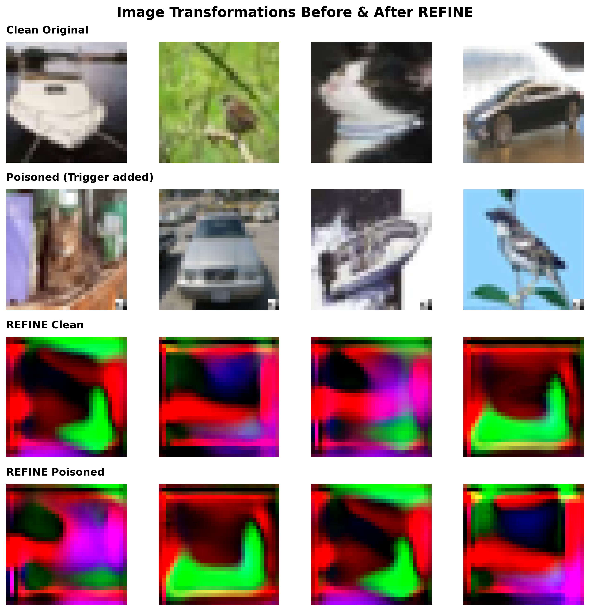
6. UNet Transformation — Pixel-Level Verification
What This Image Shows:
Row 1 — Clean original CIFAR-10 images
Row 2 — Same images + BadNets trigger
(3×3 white patch, bottom-right corner)
Row 3 — Clean images after UNet
Row 4 — Poisoned images after UNet
Observation:
The UNet converts all images into abstract
adversarial textures. These look scrambled to
humans but preserve the mathematical features
that ResNet needs for classification.
The rigid 3×3 trigger is physically warped
and destroyed in this process!

Slide 9
7. Our Novel Contributions
① Feature-Space Interpretability Pipeline (Implemented)
The original paper does not provide visual analysis of the model's latent space. We built a full t-SNE pipeline that
extracts 512-dim features from ResNet-18's penultimate layer → reduces to 2D → provides direct visual proof that the
backdoor cluster is destroyed. This adds explainability — critical for trust in security-sensitive deployments.
② Pixel-Level Trigger Destruction Verification (Implemented)
We reconstructed and visualized the exact pixel outputs of the UNet to confirm that the 3×3 BadNets trigger patch
is physically warped beyond recognition, providing concrete evidence beyond accuracy numbers alone.
③ Stronger Empirical Defense Than Reported
Our reproduction achieved ASR = 0.84%, which is lower (better) than the paper's reported ~1.05–1.40%.
This independently validates that REFINE's defense mechanism is robust and reproducible.

Slide 10
8. Future Work — Suggestions for Extension
Suggestion 1: Lightweight UNet Replacement for Edge Deployment
The current UNet model is ~69 MB — too heavy for IoT and embedded devices.
Replacing it with a MobileNet-based autoencoder or a compact 3-layer CNN could reduce size by 10×
while maintaining ASR < 1.5%. This would make REFINE practical for real-time, resource-constrained systems.
Target: model size < 10 MB, BA > 89%, ASR < 1.5%
Suggestion 2: Evaluate Against Adaptive & Dynamic Triggers
BadNets uses a static, fixed-position trigger. More advanced attacks like LIRA, ISSBA, and WaNet use
sample-specific, invisible, or dynamically positioned triggers that may resist the UNet's spatial filtering.
Testing REFINE against these would reveal its generalization limits and motivate improved defenses
such as randomized test-time transformations or ensemble-based scramblers.

Slide 11
Thank You!
Questions & Discussion
Rohan Bhati • 2023UAI1809
MNIT Jaipur
ICLR 2025 — REFINE Paper
github.com/WhitolfChen/REFINE

